Slide 1
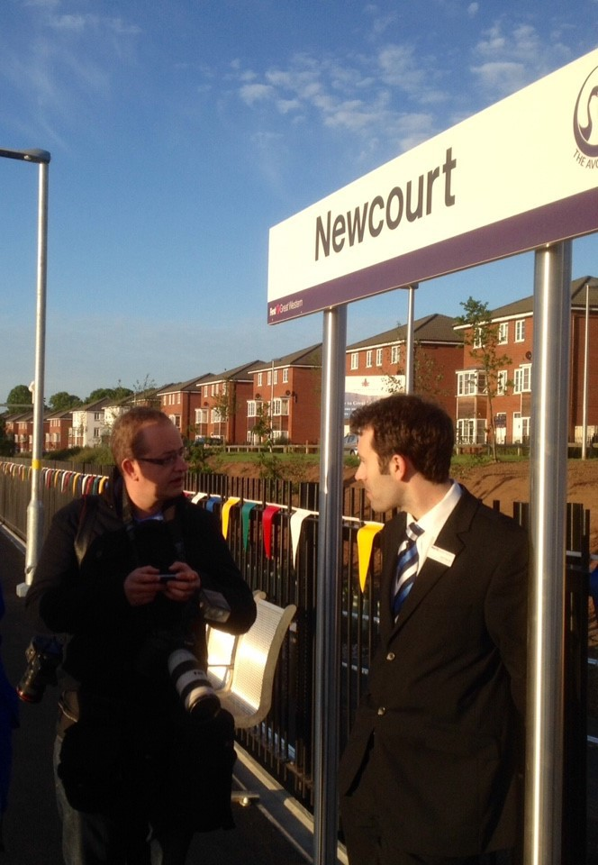
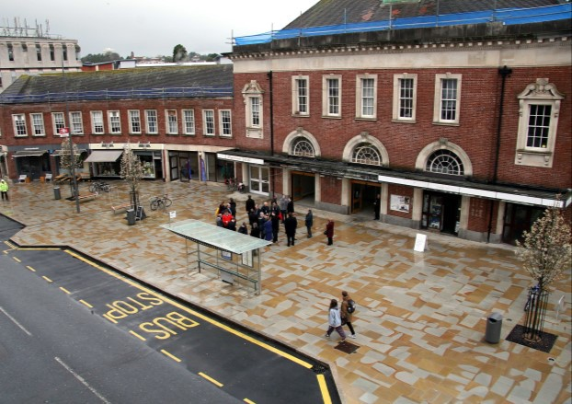
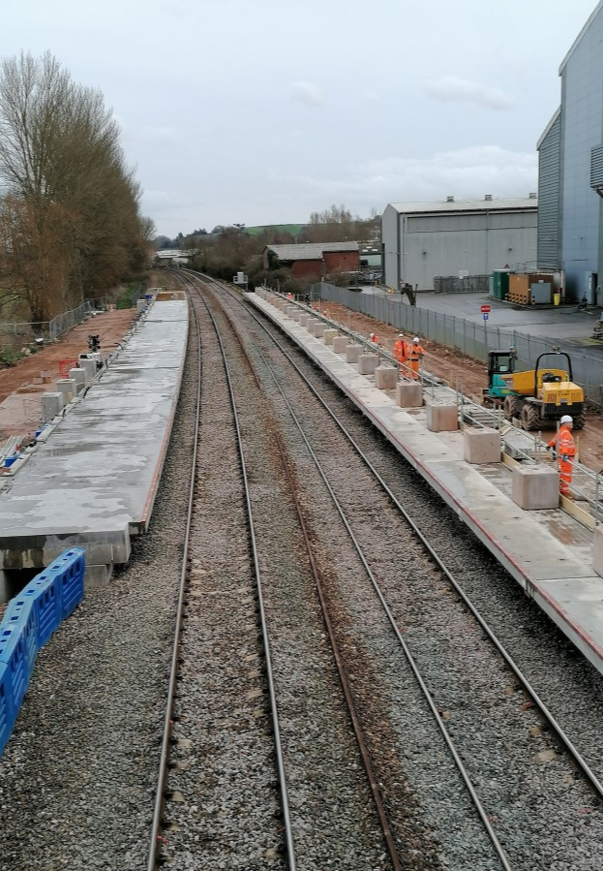
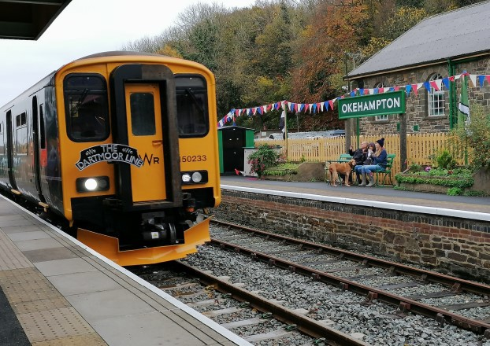
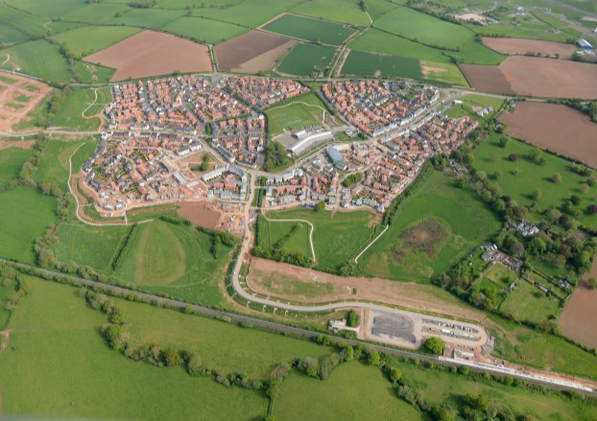
jamie.hulland@devon.gov.uk Transportation Strategy & Road Safety Manager

Slide 2
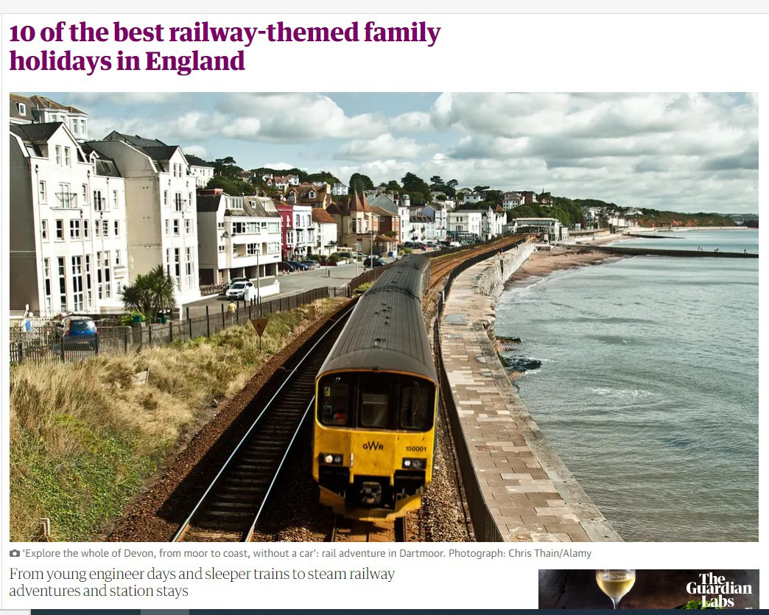
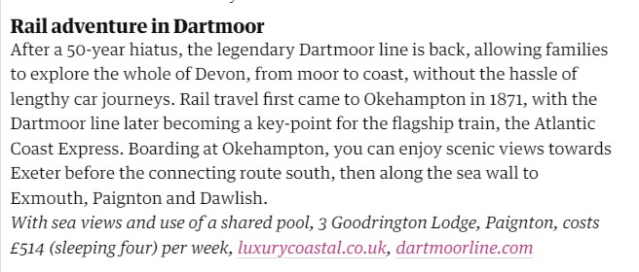

Slide 3
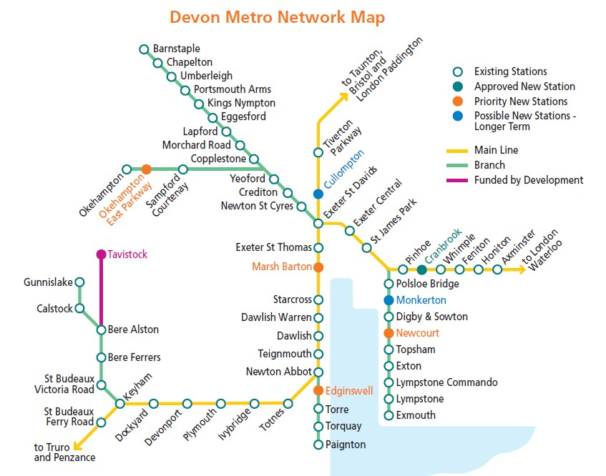
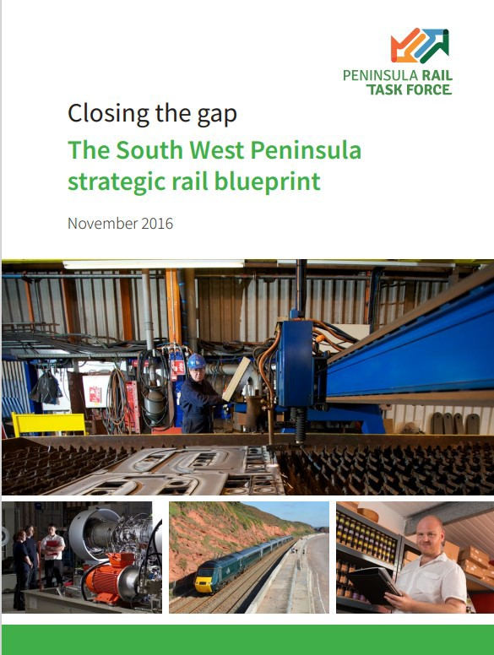
Devon Metro Vision
Devon Rail Priorities
Red outline – Devon CC projects
Blue outline – Other Council projects

Slide 4
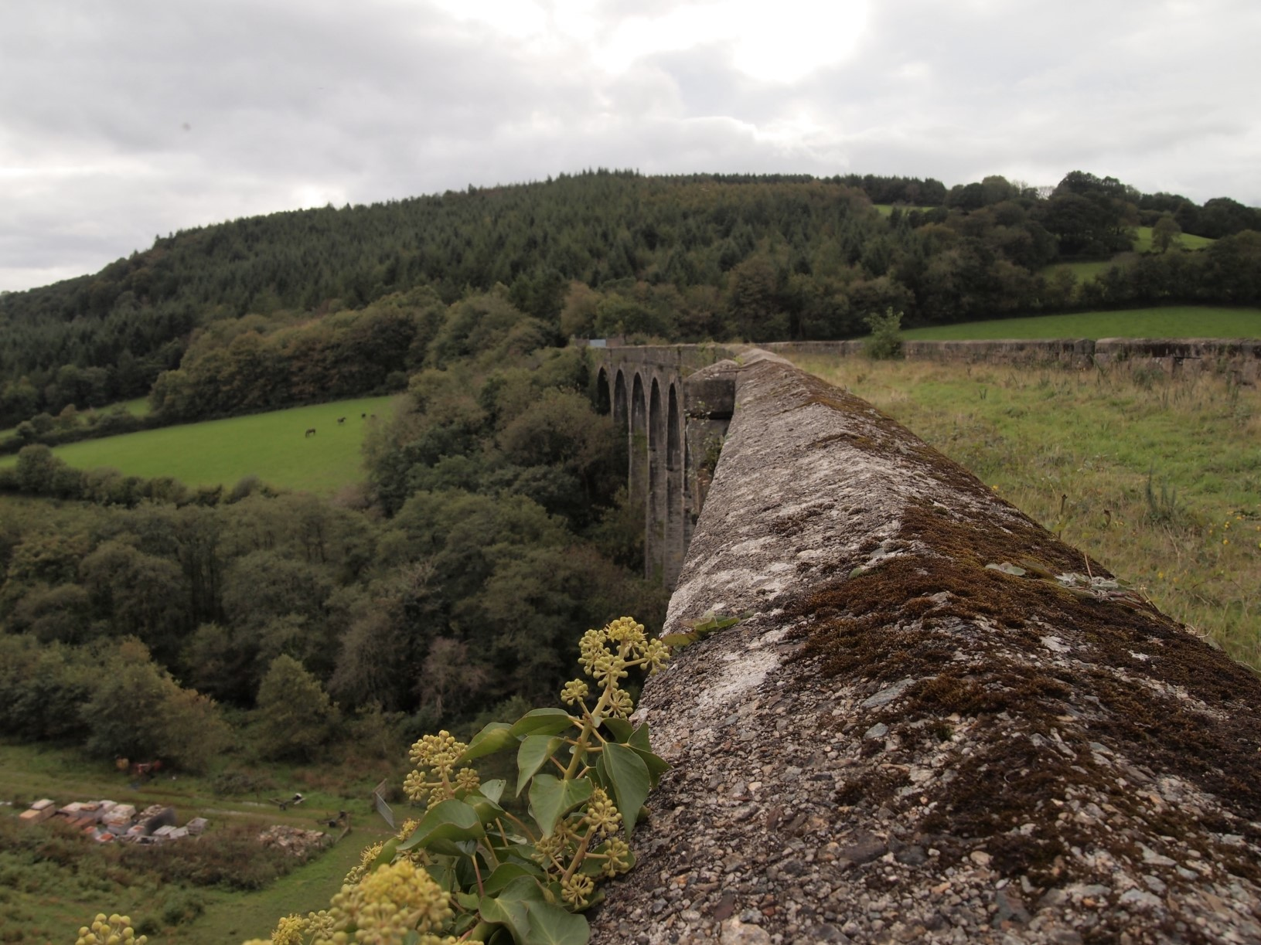
Tavistock to Plymouth Railway reopening
Shillamill Viaduct
STRATEGIC OUTLINE BUSINESS CASE
(what is it and what is the process?)
ENGINEERING & OPERATIONAL REVIEW

Slide 5
Restoring Your Railway
Ideas Fund
Objectives:
Better connectivity driving local economic growth
Reconnecting communities
Regeneration of communities and restoring lost connectivity as a result of railway closures

Slide 6
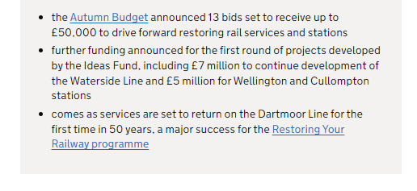
“The Process”

Slide 7
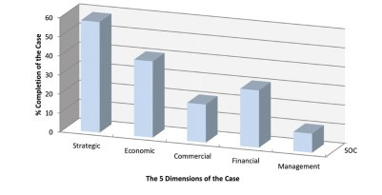
Business Case Development
Stage 1

Slide 8
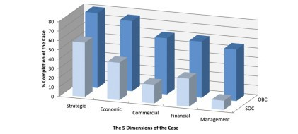
Business Case Development
Stage 2

Slide 9
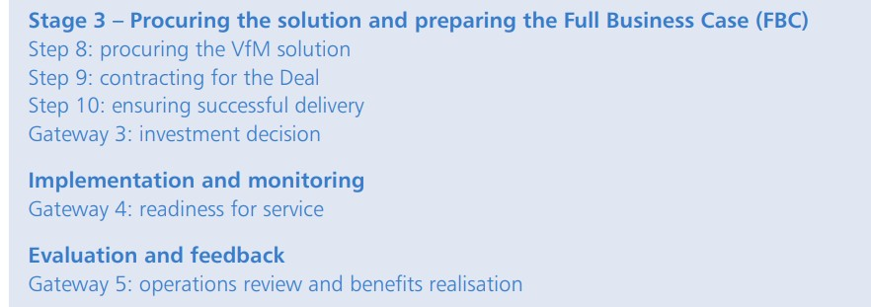
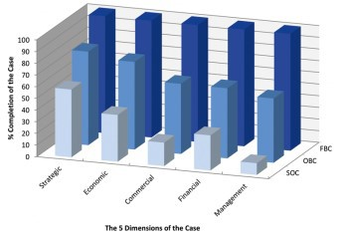
Business Case Development
Stage 3

Slide 10
Project Team
WSP have been appointed (through Devon’s framework) to produce an SOBC, to better understand the business case to reopen this line
WSP are part way through this process and have completed an engineering and operational review

Slide 11
Project Governance
RYR PROJECT BOARD
Devon County Council (incl WSP Proj Mgr) Department for Transport Network Rail
Great Western Railway
RYR STEERING BOARD
Devon County Council (incl WSP Project Team) Network Rail
Great Western Railway Plymouth City Council
Heart of the South West LEP Devon & Cornwall Rail Partnership
Meets monthly
Meets monthly

Slide 12
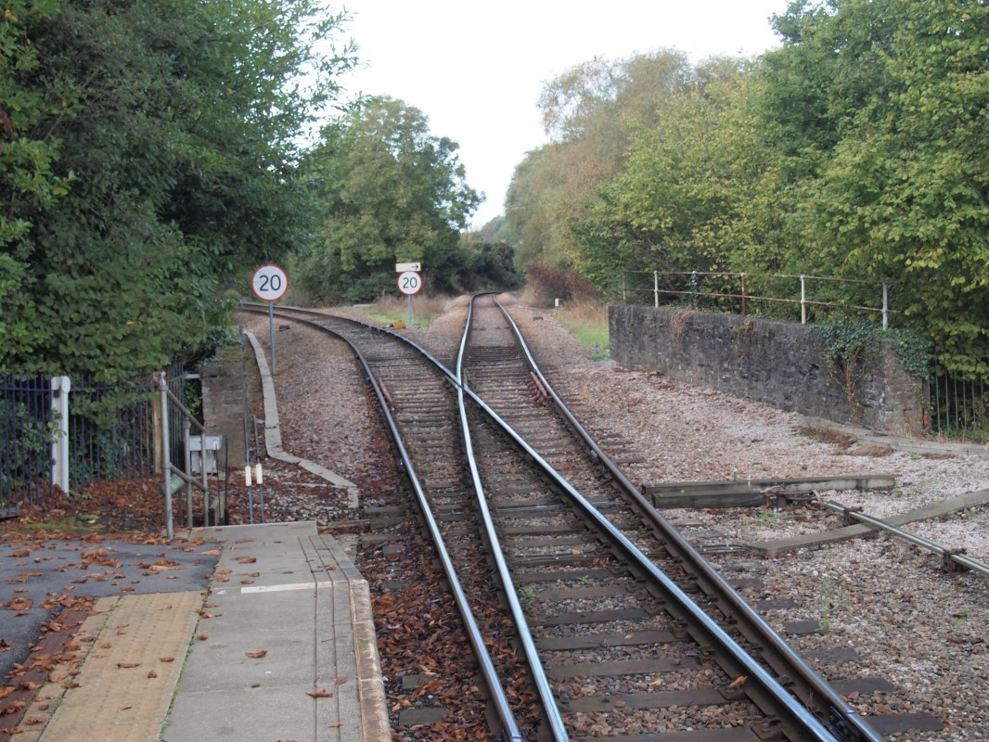
Strategic Outline Business Case (SOBC) Indicative Programme
Review and validate past work – February ‘22
Option Assessment Report – March ‘22
5 Case Model:
Strategic
Economic
Financial
Commercial
Management
SOBC submission by Summer 2022

Slide 13
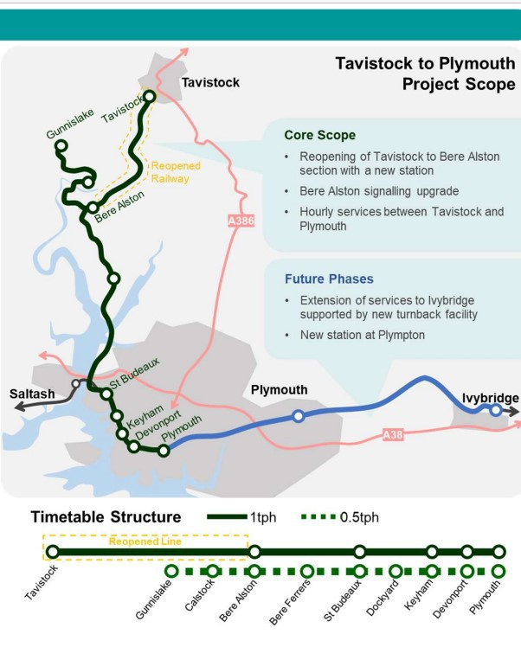
Tavistock to Plymouth Railway
Restoring Your Railway Ideas Fund
THE CASE:
Driving modal shift and
decarbonisation
Accessing jobs, training and skills for Tavistock residents
Trebling train services for deprived communities in Plymouth
Devonport dockyard accessibility boosted

Slide 14
Developing the Strategic Case:
Objectives of the Scheme
Enhanced connectivity encouraging mode shift from car to rail for journeys between Tavistock and Plymouth, addressing congestion on the A386 corridor and tackling the Climate Emergency by supporting lower carbon travel
Facilitate local development, as laid out in the Plymouth and South West Devon Joint Local Plan (JLP)
Enhanced access to employment, education and healthcare in Plymouth for Tavistock residents and residents of west Devon and north Cornwall
Provide an improvement in rail services for the deprived
communities of St Budeaux, Keyham and Devonport in Plymouth
Improve visitor access by public transport to the natural environment, particularly the Dartmoor National Park

Slide 15
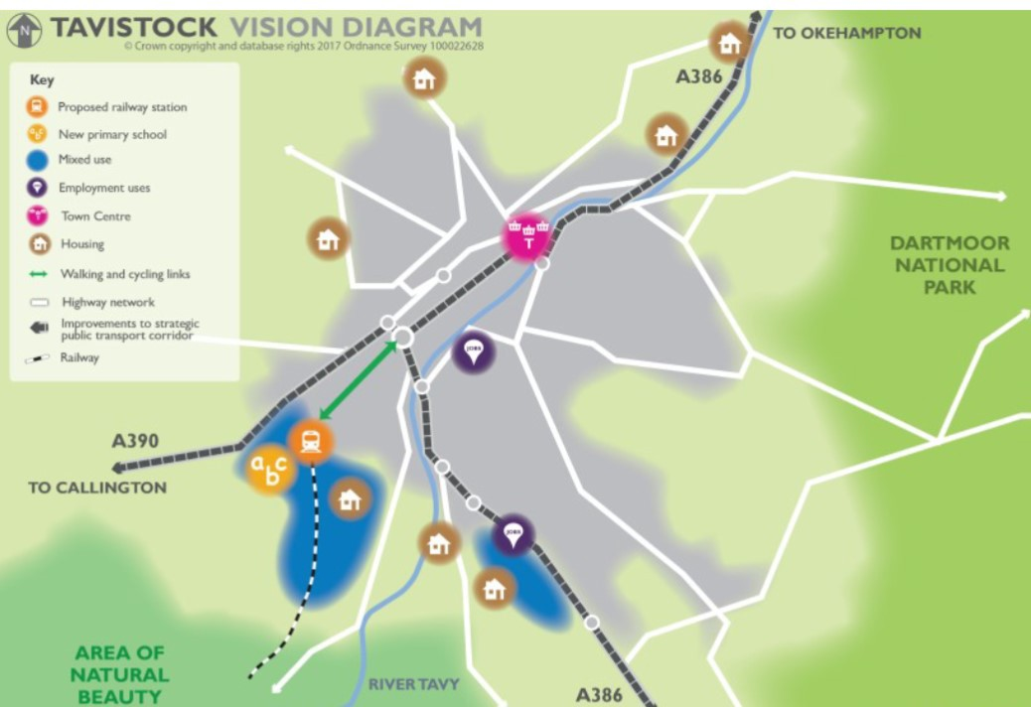
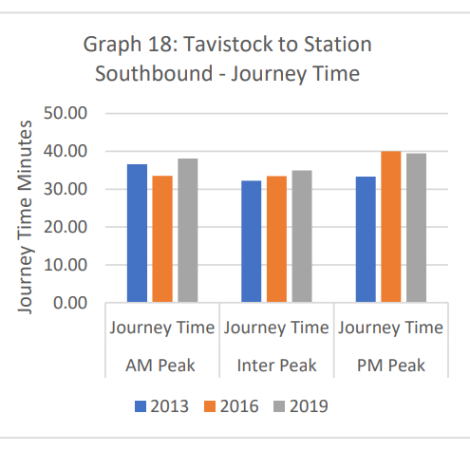
Supporting Growth
Encouraging Mode Shift

Slide 16
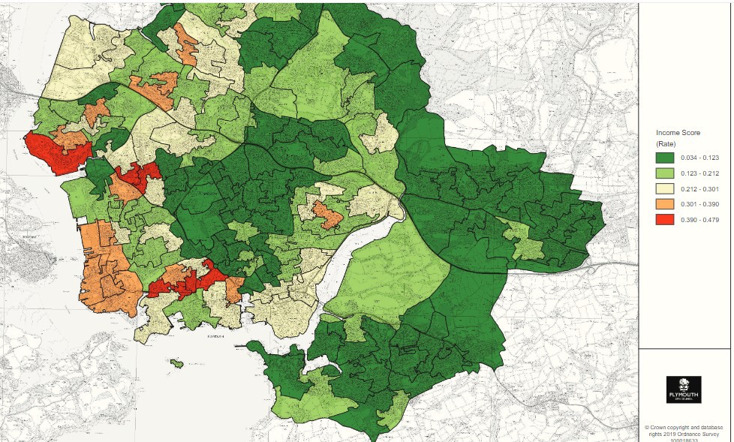
- Improving Access within Plymouth
Income Score
St Budeaux
Keyham
Devonport

Slide 17
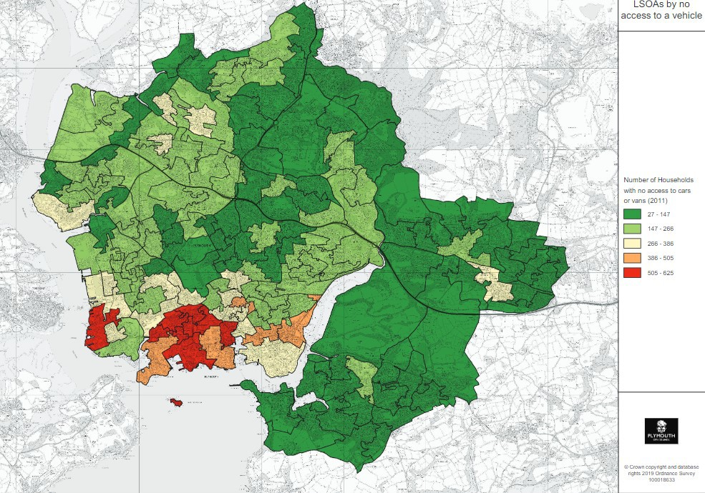
- Improving Access within Plymouth
Access to a Car
St Budeaux
Keyham
Devonport

Slide 18
Engineering and Operational Review
Previous Design Work
Approx. 5 miles with ruling gradient 1:68
Single line throughout
55 mph line speed
30 mph approaching Tavistock
Existing speeds at Bere Alston
Alignment makes best use of two-track formation to maximise speed
Track located away from predicted rock fall zones in cuttings where possible
700m safe cess walkway throughout
c.80% land secured

Slide 19
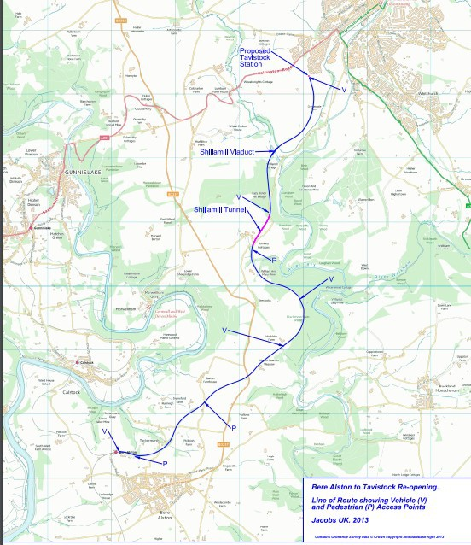
Bridges, Culverts & Retaining Walls
16 bridges over or under
railway
1 viaduct
Crowndale ‘Mine’ _{1 missing bridge}
Shillamill
Shillamill Viaduct
5 culverts
2 retaining walls
Key:
needs replacing & abutments pinning back needs new bridge
deep in embankment – need masonry repair needs fencing to retain heritage status
Cattle Creep
Lazy Bench Hill
Ravens Rock
Tuckermarsh Bere Alston
Bridge

Slide 20
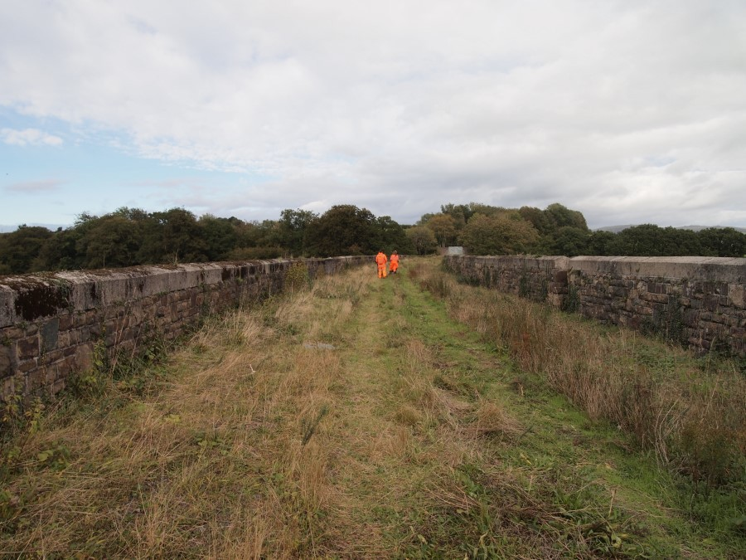
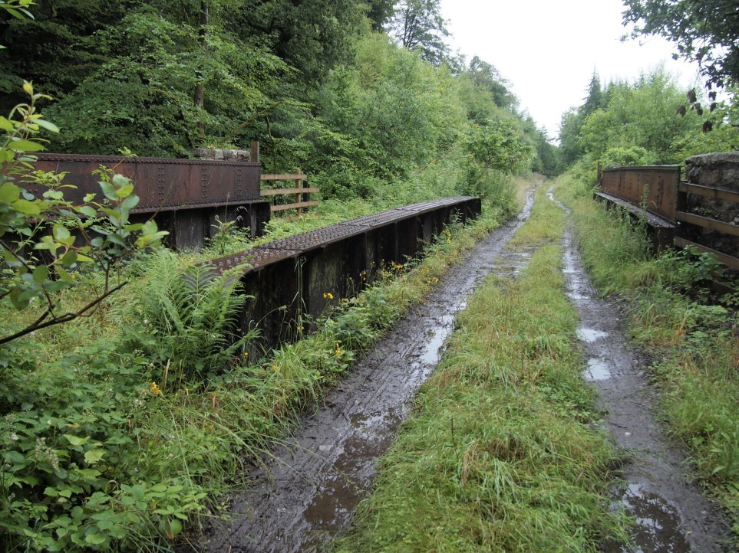
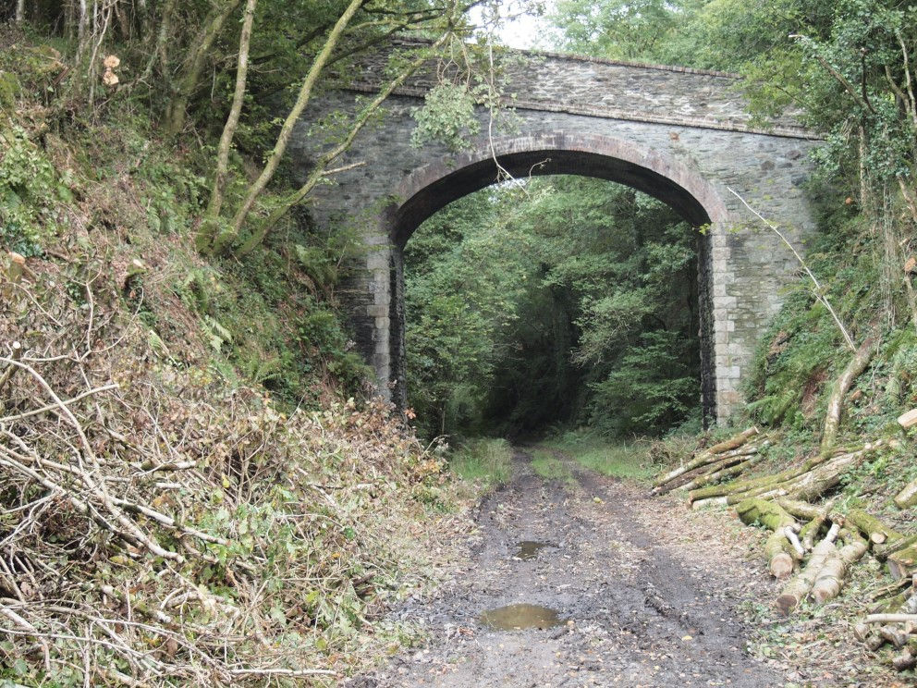
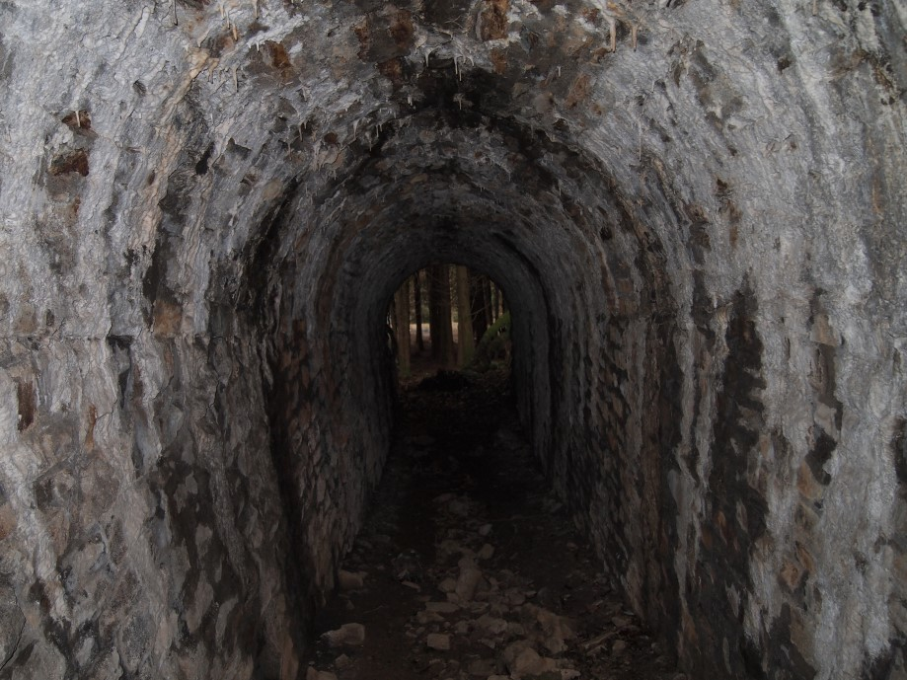
Lazy Bench Hill
Shillamill Viaduct
Ravens Rock Bridge
Shillamill Cattle Creep

Slide 21
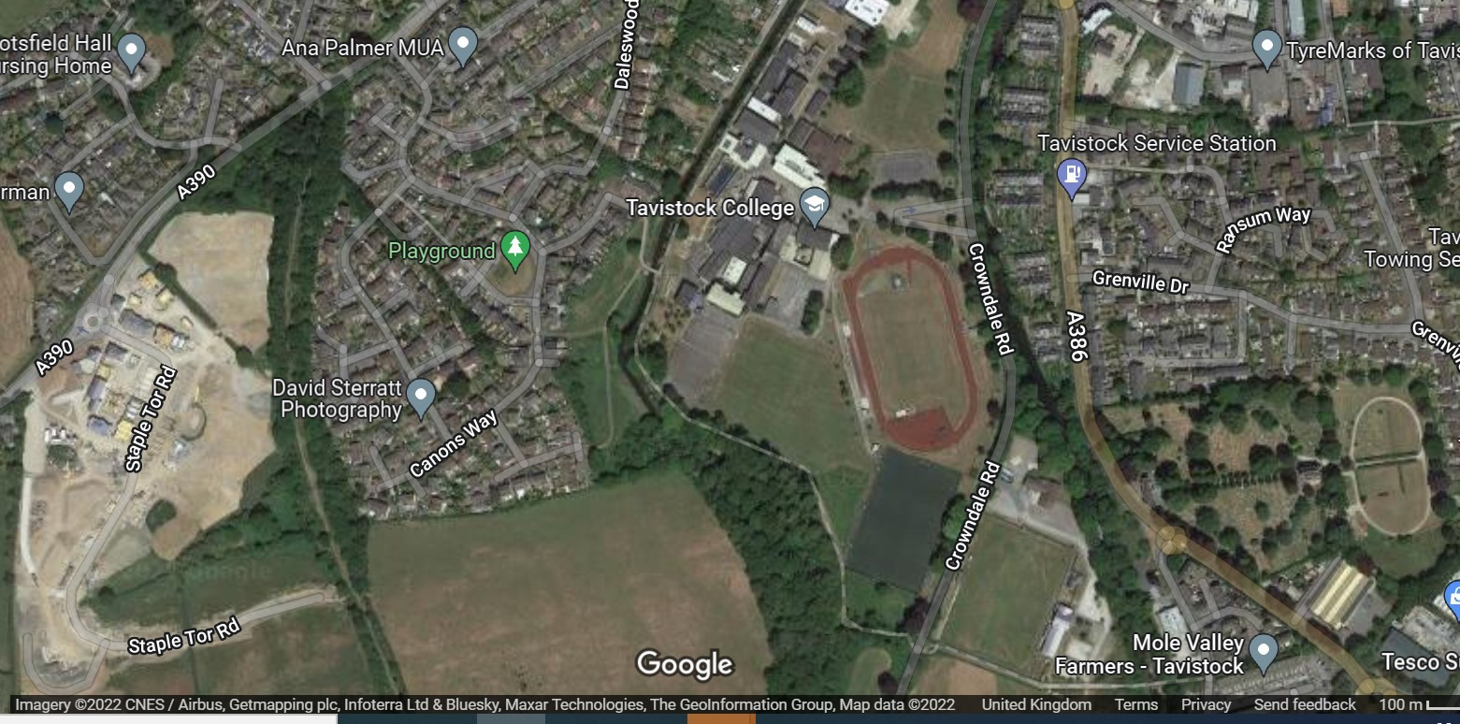
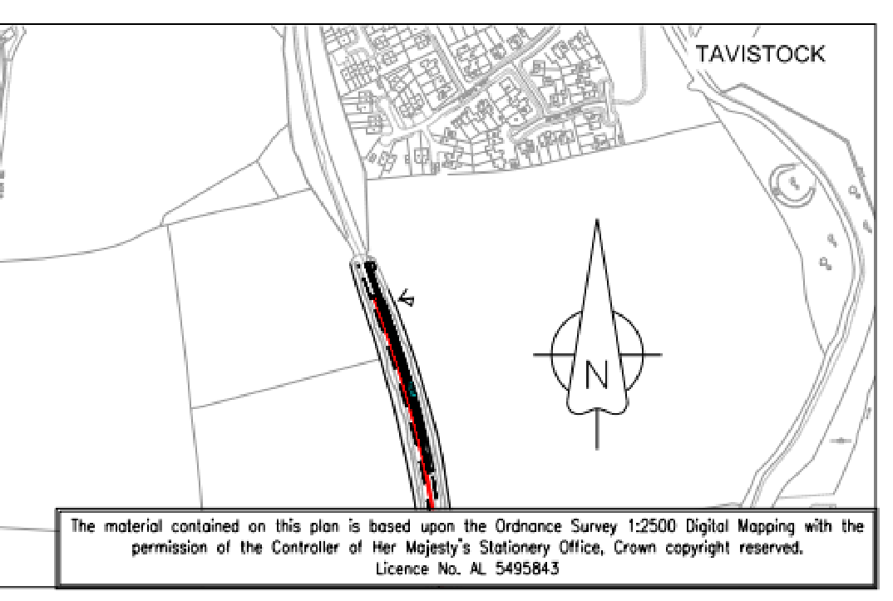
Proposed Tavistock Station
The DfT’s focus is on defining the “minimum viable product” and proposers must work with DfT as the funder to align with this approach.
Edge of town station location at Tavistock is proposed on affordability and deliverability grounds.
Significant increase in the capital cost would potentially worsen the BCR.
proposed location of Tavistock Station

Slide 22
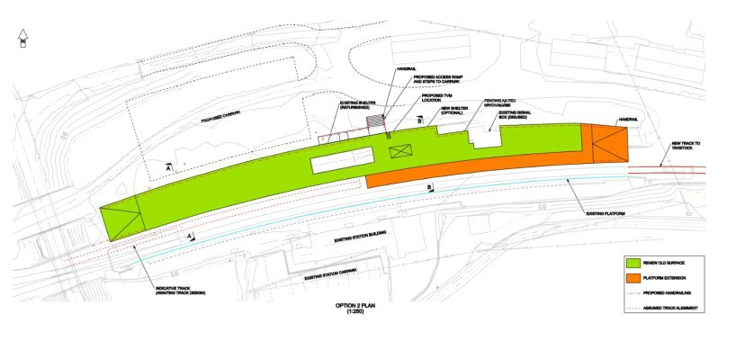
Bere Alston Station
Source: Jacobs 2015
A value engineering opportunity has been identified at Bere Alston – enhancing the BCR – to only require a single platform face (shown in orange above)

Slide 23
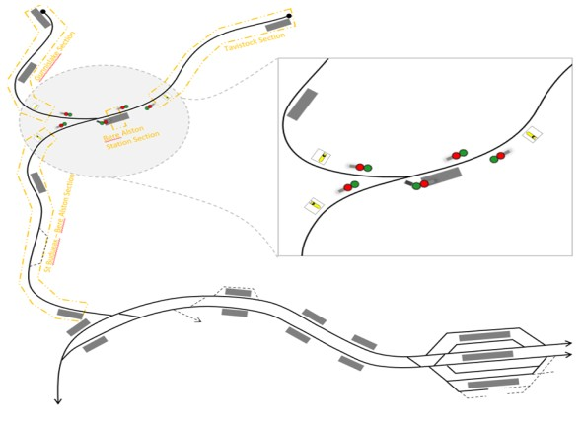
Railway Operations
GWR have developed a timetable which would deliver:
1 train per 2hr Gunnislake – Plymouth
1 train per hr Tavistock – Plymouth
There are some conflicts with the mainline which we believe could be resolved with further development (outside scope of this project)
Illustrative signalling layout
Source: GWR/Network Rail

Slide 24
Concluding Comments
Devon County Council is in a strong position as promoter, with lots of design development completed on the line.
We believe we can make a strong strategic case, not only through a link between Tavistock and Plymouth, but also delivering benefits to northwest Plymouth
To make best use of the limited RYR funding, the focus for this stage is developing:
the demand profile (and revenue)
better understanding key cost drivers; and
establishing the best possible BCR for the scheme
Engineering Review Risks:
Rock protection in cuttings, and civils remediation (e.g. Shillamill
Tunnel and Viaduct)
Potential landowner negotiations
Environmental constraints (e.g. ecological – tbc subject to survey)
Looking ahead, the historic design work gives us solid foundation for further detailed design development work.

Slide 25
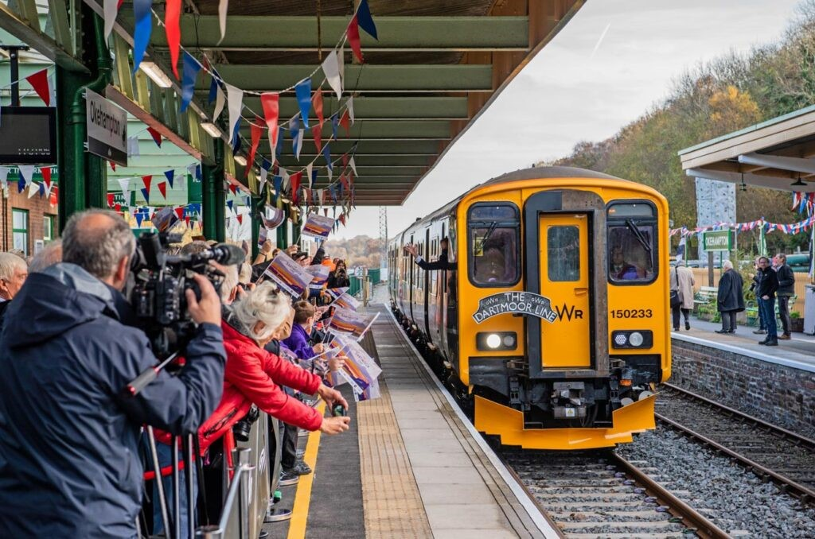
Next steps
Pending funding approval:
Thank you for listening
Sign off “approval in principle”
designs
Structures, cuttings and ground investigation surveys
Further development with Devon County Council and Plymouth City Council to maximise potential benefits
Continued productive collaboration with Network Rail and GWR

